Slide 1
Universal Forwarder Security: Don’t input more than data into your Splunk Environment
Travis Holland & Matt Uebel
Security Engineer, Defense Point Security

Slide 2




Matt Uebel
Notes:
Speaker: Matt

Slide 3

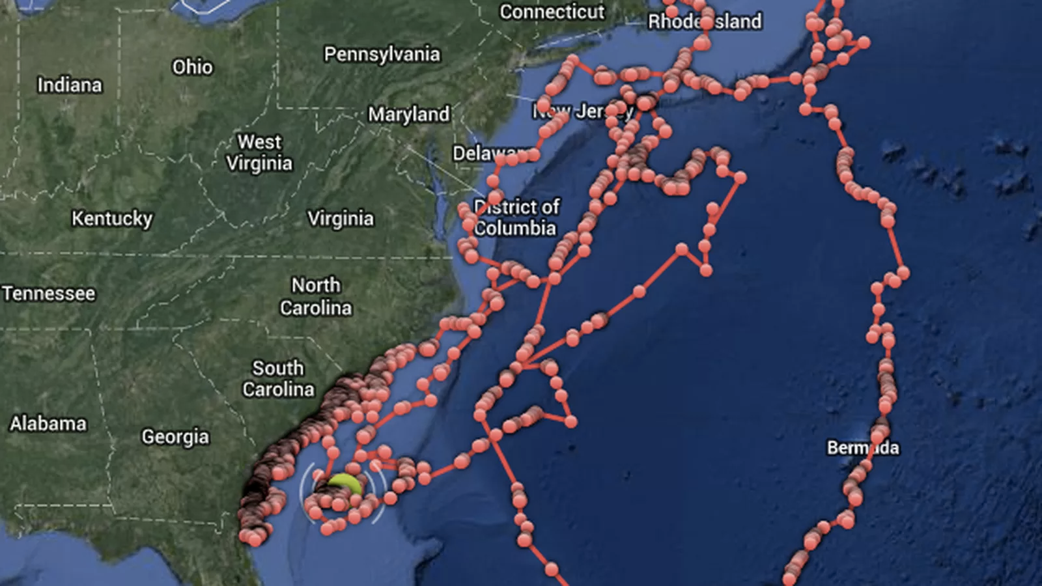
Travis Holland
Notes:
Speaker: Travis
Splunk Architect for Defense Point Security performing Splunk Professional services.
Began working with large data sets in 2008 working with satellite tag data deployed in large sharks by correlating atmospheric and oceanic data with coordinate data to predict animal migration patterns and reduce error of tag data.
Previously performed work as a security analyst and engineer for a Fortune 100 equivalent privately owned rental car company.
I want to spread security knowledge to everyone as it is no longer your security team’s sole responsibility. Everybody has a share in the success of your company's security program.

Slide 4
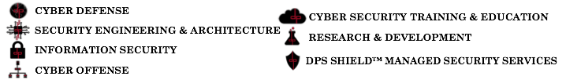

Who is DPS?
DPS is one of the largest privately owned, small businesses exclusively providing cyber security services and solutions to the federal government and commercial corporations.
Splunk Professional Service Public Sector Partner of the Year 2015
20+ Splunk Certified Architects on Staff
We use Splunk to achieve many of the expertise domains above
Notes:
Speaker: Travis and Matt

Slide 5


Agenda
Deployment of the Universal Forwarder
Discuss common vulnerabilities of a default Universal Forwarder installation
Solutions to the problem
Automation scripts and snippets
Notes:
Speaker: Travis

Slide 6
Introduction
Is it enough to harden just your Splunk Enterprise servers?
Do you understand the default configuration of a Universal Forwarder?
What are the dangers of a misconfigured Universal Forwarder?
What can Deployment Server credentials really do?
Are your Splunk admins more than Splunk admins?

Slide 7

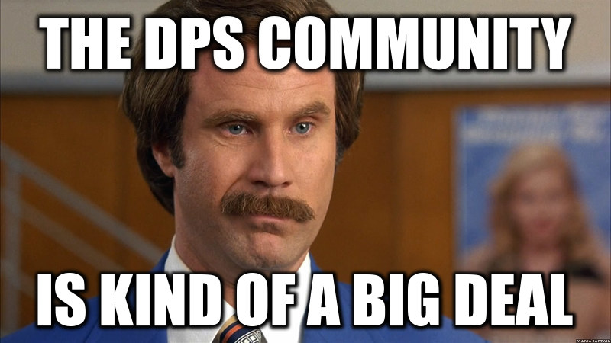
Exploitation - Universal Forwarder
Defense Point pentester successfully escalated from non-root credentials to root leveraging a misconfigured Universal forwarder
User credentials to server obtained
Engages with DPS Community
Notes:
Speaker: Travis

Slide 8
Exploitation - Universal Forwarder
Escalation from non-root to root via the Universal Forwarder
Create rogue deployment server
Change the deployment server of the universal forwarder
Restart the Universal Forwarder
Create exploitation App
App returns a root shell
Deploy App - Reap the rewards

Slide 9
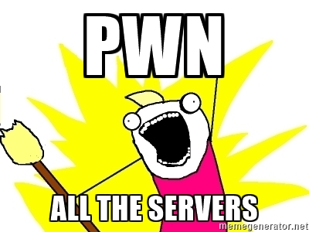
Exploitation - Bonus Scenario
Universal Forwarders Managed by Deployment Server
Legitimate Splunk admin credentials obtained
Mass Deployment of exploitation app to entire environment
Compensating Control:
Lockdown the Deployment Server
Configure forwarders appropriately
Notes:
Speaker: Travis

Slide 10

The UF Deployment Plan
Usually simply “yum/apt-get install splunkforwarder” all the things
Much more can be done
Notes:
Speaker: Matt

Slide 11

The Issues
User Account
Admin Credentials
Management Port
Deployment Server
Firewall Rules
SSL Certificates

Slide 12

Run as non-root
Setup init script specifying some user (splunk user is default)
/opt/splunkforwarder/bin/splunk enable boot-start -user splunk
chown -R splunk:splunk /opt/splunkforwarder
Lockdown splunk-launch.conf, which contains runas user config
chown root:splunk /opt/splunk/etc/splunk-launch.conf
chmod 644 /opt/splunk/etc/splunk-launch.conf
Notes:
Speaker: Matt

Slide 13
Reading files as non-root
Create a “log reading” group and add the spunk user to it, or simply change group ownership to splunk
groupadd syslog
chown -R :syslog /var/log
chmod -R g+s /var/log
usermod -a -G syslog splunk
Notes:
Speaker: Matt

Slide 14
Reading files as non-root cont.
Usual defaults have /var/log unreadable by non-root user
setfacl -Rm u:splunk:r-x,d:u:splunk:r-x /var/log
Auditd represents special case, requires modification to /etc/audit/auditd.conf
log_group = splunk
Additionally modify permission set on audit directory
chgrp -R splunk /var/log/audit chmod 0750 /var/log/audit chmod 0640 /var/log/audit/*
Notes:
Speaker: Matt

Slide 15
Windows Low-privilege Mode
Suitable for typical windows system
You will need to specify a local or domain user
msiexec.exe /i splunkforwarder.msi AGREETOLICENSE=Yes LOGON_USERNAME="$env:computername\splunk" LOGON_PASSWORD="$password" SET_ADMIN_USER=0 LAUNCHSPLUNK=0 /qn

Slide 16

The Issues
User Account
Admin Credentials
Management Port
Deployment Server
Firewall Rules
SSL Certificates

Slide 17
Change admin password (nix)
Bash script to set admin password to random string
$SPLUNK_HOME/bin/splunk edit user admin -password `head -c 500 /dev/urandom | sha256sum | base64 | head -c 16 ; echo` -auth admin:changeme
GOTCHA: What if you need to issue a command?
SOLUTION: Remove $SPLUNK_HOME/etc/passwd, restart splunk
Notes:
Speaker: Matt

Slide 18
Change admin password (win)
Generate the random password.
do {
$password = (-join ((48..57) + (65..90) + (97..122) | Get-Random -Count 14 | % {[char]$_}))
} until ($password -match "[0-9]" -and $password -match "[a-z]" -and $password -match "[A-Z]")
Set that password for admin user
& "$env:programfiles\splunkuniversalforwarder\bin\splunk.exe" edit user admin -password ($password) -auth admin:changeme | out-null

Slide 19
The Issues
User Account
Admin Credentials
Management Port
Deployment Server
Firewall Rules
SSL Certificates

Slide 20
Disable Management Port (nix)
Create app directory
mkdir -p /opt/splunkforwarder/etc/apps/UF-TA-killrest/local
Generate server.conf containing config to disable management interface
echo '[httpServer]
disableDefaultPort = true' > /opt/splunkforwarder/etc/apps/UF-TA-killrest/local/server.conf
Notes:
Speaker: Matt

Slide 21
Disable Management Port (win)
Create app directory
new-item -path "$env:programfiles\splunkuniversalforwarder\etc\apps\UF-TA-killrest\local" -ItemType "Directory" -force | out-null
Generate server.conf containing config to disable management interface
"[httpServer]`r`ndisableDefaultPort = true" | out-file "$env:programfiles\splunkuniversalforwarder\etc\apps\UF-TA-killrest\local\server.conf" -force | out-null

Slide 22
The Issues
User Account
Admin Credentials
Management Port
Deployment Server
Firewall Rules
SSL Certificates

Slide 23
The Deployment Server
Splunk’s configuration control system, can potentially run arbitrary commands on systems through scripted inputs.
This and a Universal Forwarder running as root/system can easily take over an environment
Notes:
Speaker: Travis

Slide 24

Watch for Rogue DS
This will need adjusted based on your environment
index=_internal sourcetype=splunkd DeployedApplication Downloaded url!=your-ds-server*
Notes:
Speaker: Travis

Slide 25
Who has access to DS?
Careful consideration for auth config
Default user role doesn’t allow interaction with DS interface
How many users in admin role?
Notes:
Speaker: Travis

Slide 26
Monitor Deploy Capable Users
While in known good state, make lookup
| rest splunk_server=local /services/authentication/users | search capabilities=edit_deployment* OR capabilities=list_deployment* | eval username=title | eval permitted="True" | table username permitted | outputlookup deploy_capable_users.csv

Slide 27
Monitor Deploy Capable Users cont.
on some schedule, search to find any users not in lookup
| rest splunk_server=local /services/authentication/users | search capabilities=edit_deployment* OR capabilities=list_deployment* | eval username=title | table username | lookup deploy_capable_users.csv username OUTPUTNEW permitted | search NOT permitted=*

Slide 28
Watching Audit Log for Bundle Reloads
Useful in particular for off hours events
index=_audit action=list_deployment_server info=granted object="_reload" operation="_reload"

Slide 29
Gather Bash History
DS App modification require some interaction with the file system
Can add a layer of protection by gathering bash commands
See repo for more details

Slide 30
The Issues
User Account
Admin Credentials
Management Port
Deployment Server
Firewall Rules
SSL Certificates

Slide 31
SSL Certificates and Firewall Rules
Control the flow of communication
Splunk SSL ConfigurationSSLippery Slope - George and Duane's SSL Talk
Network or Host based Firewall
Rules will vary across organizations

Slide 32
The Issues
User Account
Admin Credentials
Management Port
Deployment Server
Firewall Rules
SSL Certificates

Slide 33
What Now?
Keeping the Junk Out of Splunk
Worst Practices… and How to Fix Them
Shop Smart at the KV Store: Best Value Tricks from the Splunk KV Store and REST API
Lesser Known Search Commands
Fields, Indexed Tokens and You
Notes:
Speaker: Matt

Slide 34
Links
Code Repository for Scripts related to this talk
Great answers post on the topic of reading logs as non-root user
Skip's change admin password app
Splunk Answers
Splunk Community Slack ( Nebraska User Group setup this form )
Splunk IRC - #splunk on EFNet
Notes:
Speaker: Matt

